Slide 1
Data Visualization for Financial Statements

Slide 2
Financial Insights Project
The Financial Insights Project aims to leverage enriched financial datasets for in-depth analysis, enabling the organization to make data-driven decisions.
By performing exploratory data analysis (EDA), we seek to:
uncover trends
identify key financial indicators
extract valuable insights to enhance strategic planning and optimize financial performance.

Slide 3
The Financial Insights Project will focus on analysing historical financial data from multiple sources, including:
market cap
revenue
gross profit
net income and other key financial metrics.
The scope encompasses data from 2013 to 2014.

Slide 4
NUMERICAL ANALYSIS
The mean, standard deviation and median values were calculated.
The mean depicts the average cost associated with each data group.
The standard deviation from the average cost was necessary to account for differences in cost.

Slide 5
The various means are as follows:
Data | Mean
Market Cap(in B USD) | 175.848864
Revenue | 56812.678702
Gross Profit | 27545.814532
Net Income | 8470.150596
Earning Per Share | 0.782511
EBITDA | 14760.361217
Share Holder Equity | 53023.433979
Cash Flow from Operating | 11339.235574
Cash Flow from Investing | -6323.103234

Slide 6
Data | Mean
Cash Flow from Financial Activities | -2087.00
Current Ratio | 1.3224
Debt/Equity Ratio | 0.3164
ROE | 9.8734
ROA | 6.0682
ROI | 7.5468
Net Profit Margin | 11.6899
Free Cash Flow per Share | 0.0651
Return on Tangible Equity | 16.2814
Number of Employees | 106700.0000
Inflation Rate(in US) | 1.6222
Data
Mean

Slide 7
The standard deviation from the mean of the different data is as follows:
Data | Standard deviation
Market Cap(in B USD) | 184.251925
Revenue | 45731.547071
Gross Profit | 20978.010247
Net Income | 11537.243136
Earning Per Share | 4.271091
EBITDA | 17015.476567
Share Holder Equity | 45267.244633
Cash Flow from Operating | 19644.662073
Cash Flow from Investing | 12752.985176
Cash Flow from Financial Activities | 10585.259289

Slide 8
Data | Standard deviation
Current Ratio | 1.518842
Debt/Equity Ratio | 1.468276
ROE | 20.907196
ROA | 7.020664
ROI | 12.373381
Net Profit Margin | 9.585452
Free Cash Flow per Share | 2.164338
Return on Tangible Equity | 171.354353
Number of Employees | 111201.691082
Inflation Rate(in US) | 0.066647

Slide 9
The median value in each data group is:
Data | Median
Market Cap(in B USD) | 108.4800
Revenue | 52708.0000
Gross Profit | 21915.0000
Net Income | 4757.8000
Earning Per Share | 1.4200
EBITDA | 9593.7010
Share Holder Equity | 55865.0000
Cash Flow from Operating | 5865.0000
Cash Flow from Investing | -4714.0000
Cash Flow from Financial Activities | -2087.0000
Current Ratio | 1.3224

Slide 10
Data | Median
Debt/Equity Ratio | 0.3164
ROE | 9.8734
ROA | 6.0682
ROI | 7.5468
Net Profit Margin | 11.6899
Free Cash Flow per Share | 0.0651
Return on Tangible Equity | 16.2814
Number of Employees | 106700.0000
Inflation Rate(in US) | 1.6222

Slide 11
GRAPHICAL ANALYSIS
Histograms, boxplots, a bar plot and a correlation heatmap were used in the graphical analysis
Histograms were used to show the frequency with which values occurred.
Box plots were used as they depict outliers in data.
The bar plot was used as it compares the values between years in an easily interpretable way.
The correlation Heatmap was used as it shows the degree of correlation between figures.

Slide 12
HISTOGRAMS
The Histograms show the frequency with which each variable occurs.

Slide 13
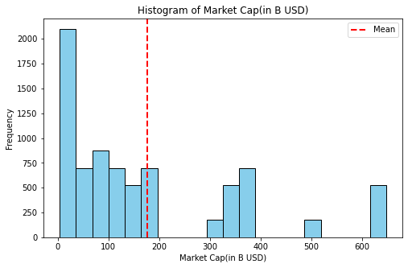
Histogram of Market Cap(in B USD)

Slide 14
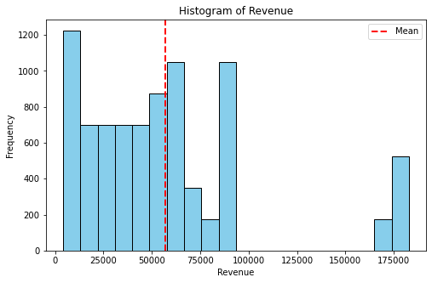
Histogram of Revenue

Slide 15
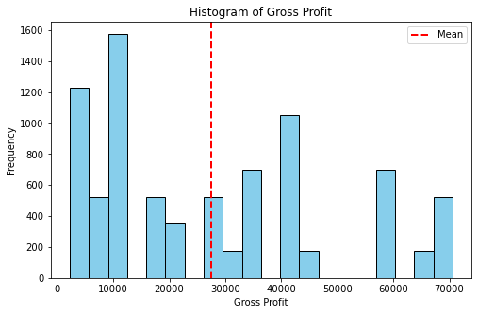
Histogram of Gross Profit

Slide 16
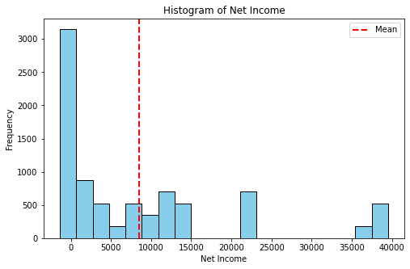
Histogram of Net Income

Slide 17
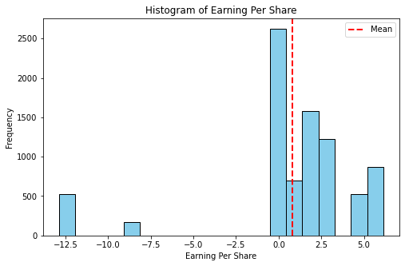
Histogram of Earning Per Share

Slide 18
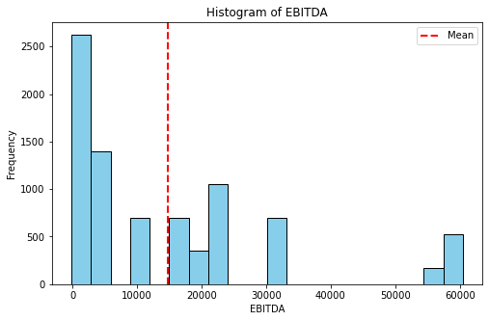
Histogram of EBITDA

Slide 19
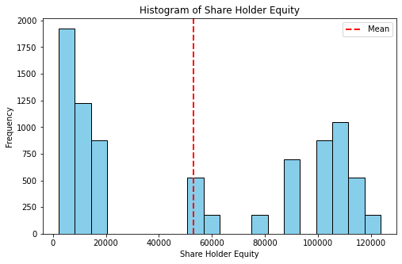
Histogram of Share Holder Equity

Slide 20
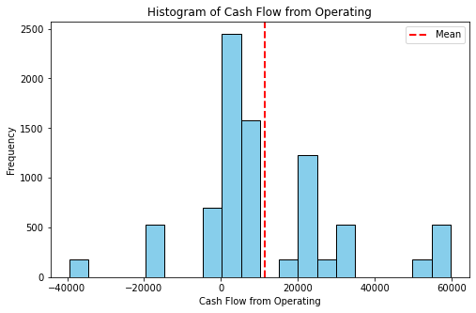
Histogram of Cash Flow from Operating

Slide 21
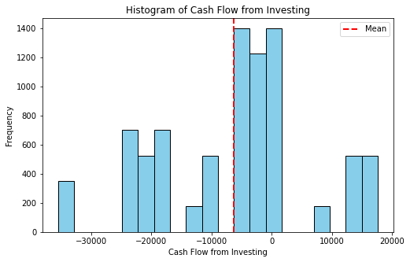
Histogram of Cash Flow from Investing

Slide 22
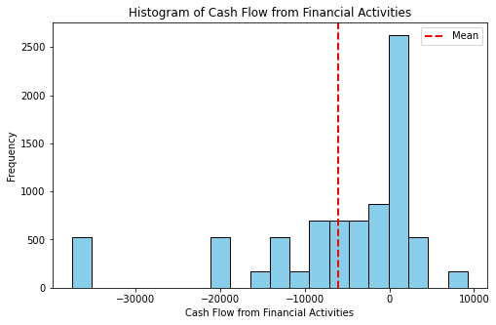
Histogram of Cash Flow from Financial Activities

Slide 23
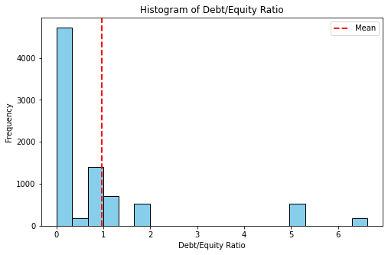
Histogram of Debt/Equity Ratio

Slide 24
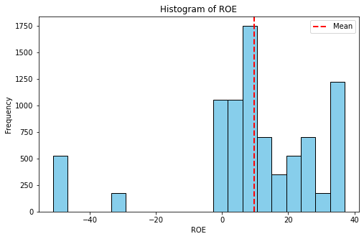
Histogram of ROE

Slide 25
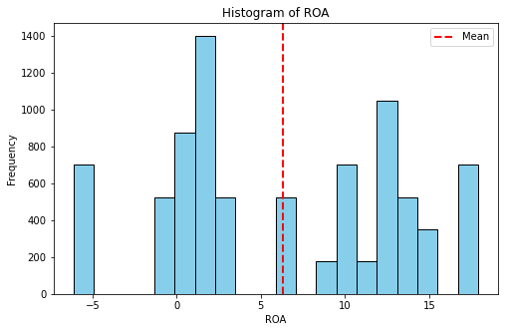
Histogram of ROA

Slide 26
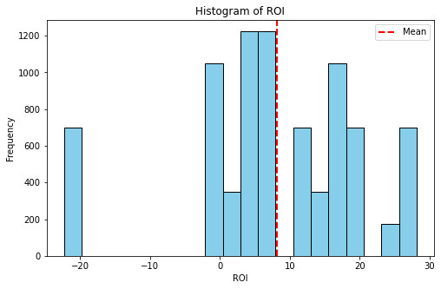
Histogram of ROI

Slide 27
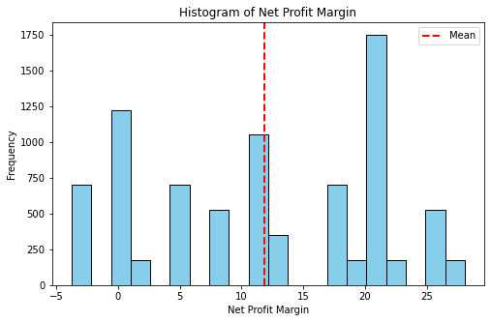
Histogram of Net Profit Margin

Slide 28
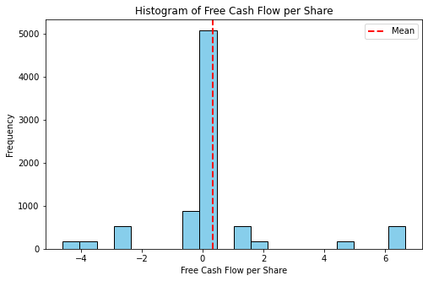
Histogram of Free Cash Flow per Share

Slide 29
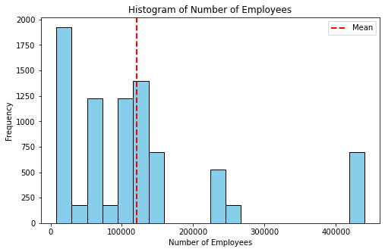
Histogram of Number of Employees

Slide 30
BOX PLOTS

Slide 31
The box plot is a standardized way of displaying the distribution of a data set based on its five-number summary of data points: the “minimum,” first quartile [Q1], median, third quartile [Q3] and “maximum.
They can tell you about your outliers and their values, if your data is symmetrical, how tightly your data is grouped and if and how your data is skewed
Box plots can also be used to identify potential outliers, which are data values that are far away from other data values

Slide 32
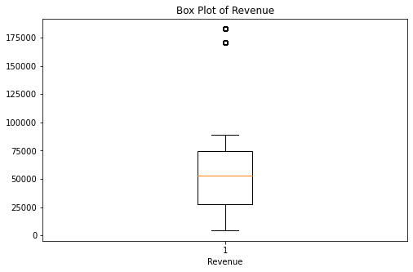
Box Plot of Revenue

Slide 33
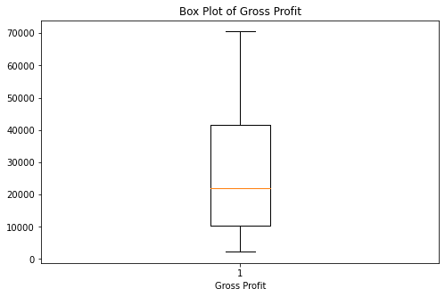
Box Plot of Gross Profit

Slide 34
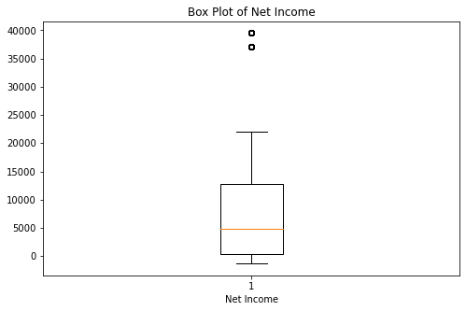
Box Plot of Net Income

Slide 35
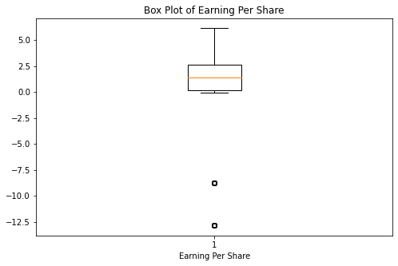
Box Plot of Earning Per Share

Slide 36
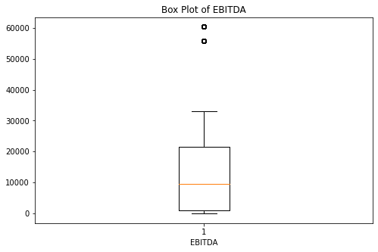
Box Plot of EBITDA

Slide 37
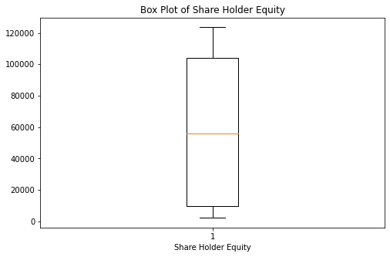
Box Plot of Share Holder Equity

Slide 38
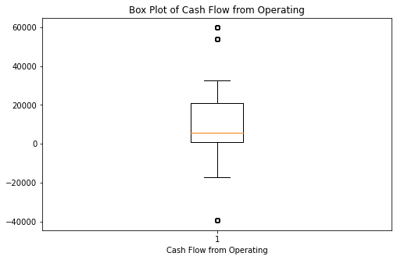
Box Plot of Cash Flow from Operating

Slide 39
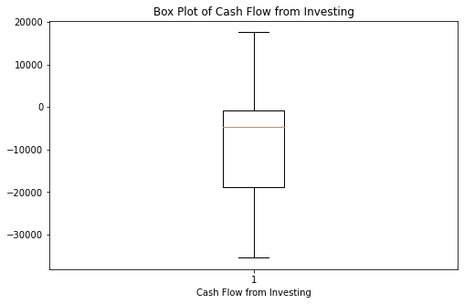
Box Plot of Cash Flow from Investing

Slide 40
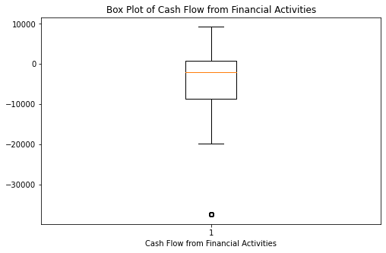
Box Plot of Cash Flow from Financial Activities

Slide 41
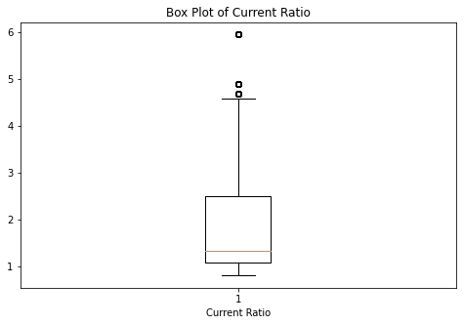
Box Plot of Current Ratio

Slide 42
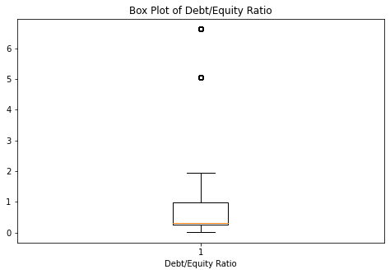
Box Plot of Debt/Equity Ratio

Slide 43
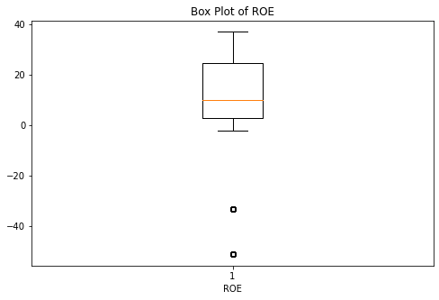
Box Plot of ROE

Slide 44
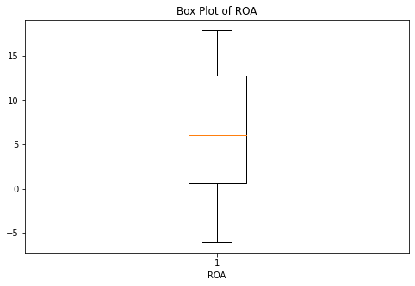
Box plot of ROA

Slide 45
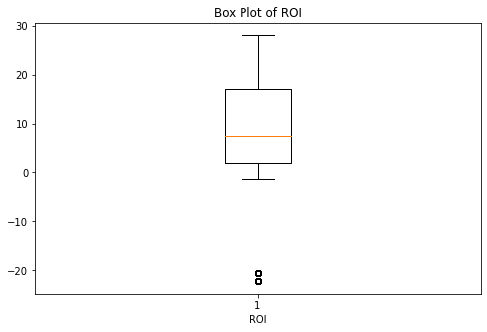
Box Plot of ROI

Slide 46
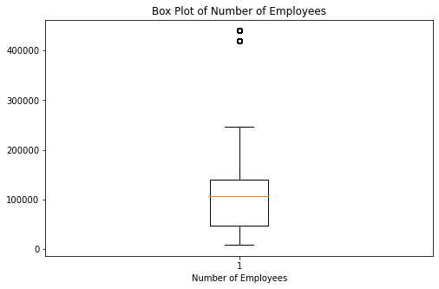
Box plot of number of employees

Slide 47
BAR GRAPH

Slide 48
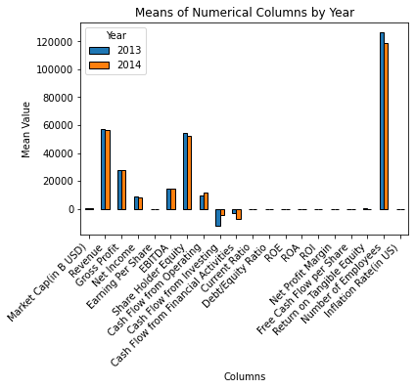
Bar Graph Comparing Means Of Numerical Data Of The Years 2013 And 2014

Slide 49
BAR GRAPH INTERPRATATION
The most notable change from 2013 to 2014 is a significant increase in the Inflation Rate in US.
Metrics like “Market Cap in USD”, “Revenue”, and “Gross Income” show noticeable differences between the two years while others like “Current Ratio” and “Debt/Equity Ratio” have minimal changes.

Slide 50
PAIR PLOT

Slide 51
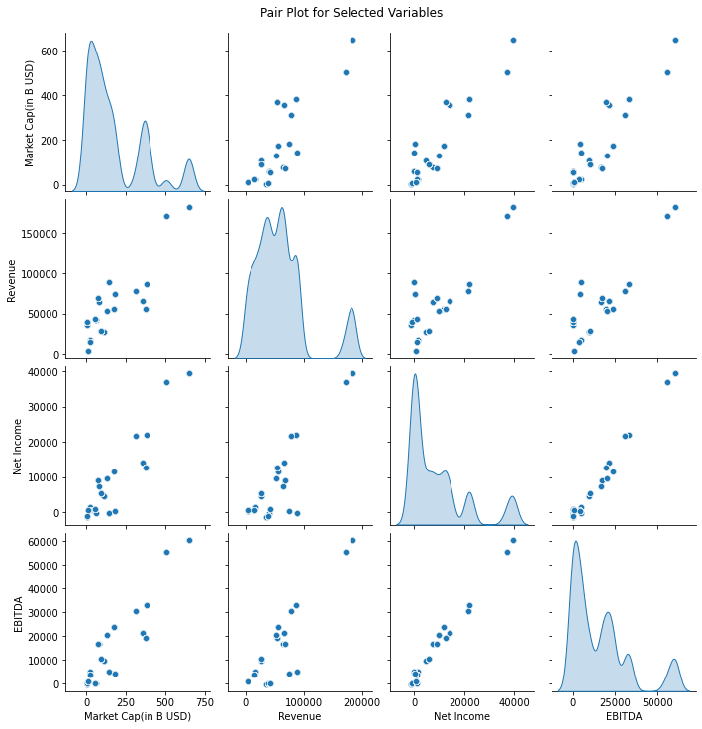

Slide 52
PAIR PLOT INTERPRETATION
The pair plot is essential for comparing several values as pairs against each other.
The plots from the top left to bottom right are the same values compared against themselves hence the appearance of a line graph.
Most of the variables have a positive correlation suggesting an increase in one could cause an increase in the other. For example:
As revenue increases, so does the market cap.
The concentration for the variables is highest from the middle to lower ranges as compared to higher ranges,

Slide 53
CORRELATION HEAT MAP

Slide 54
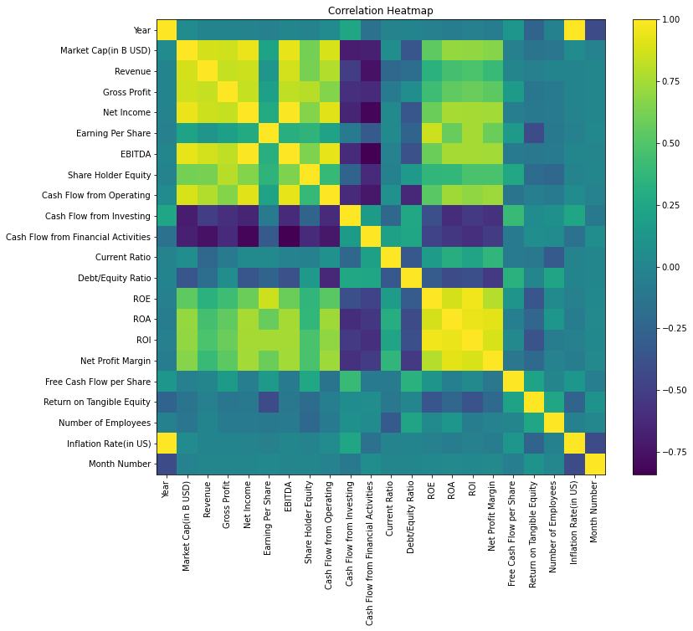
Correlation Heatmap

Slide 55
Correlation Heatmap Interpretation
This correlation heatmap visualizes the relationships between various financial metrics and indicators.
The colours range from dark purple, indicating a strong negative correlation
to dark green, indicating a strong positive correlation.
Lighter colours represent weaker correlations.
For example, there is a strong positive correlation between EBITDA and Gross Profit as indicated by the dark green colour.

Slide 56
VIOLIN PLOT

Slide 57
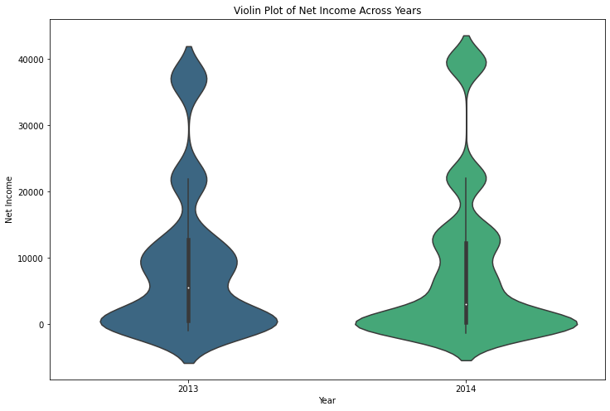
VIOLIN PLOT OF NET INCOME ACROSS YEARS

Slide 58
VIOLIN PLOT INTERPRETATION
The width of each plot at different income levels indicates the density or frequency of data points at those levels.
In 2013, there’s a wider distribution indicating more variance in net income, while in 2014, the distribution is narrower and skewed towards higher income levels.
The violin for year 2013 shows a broader distribution with a significant concentration around the lower and upper-middle income ranges.
The violin for year 2014 has a narrower shape, indicating less variance in net income with most data points concentrated around higher incomes.

Slide 59
CONCLUSION
The analysis highlights notable patterns in the dataset, revealing positive correlations among key financial indicators—Cash Flow from Operating, Market Cap, Revenue, Gross Profit, and Net Income.
Conversely, Cash Flow from Investing and Financial Activities exhibit strong negative correlations with several variables, including Market Cap, Gross Revenue, Revenue, Net Income, EBITDA, and Cash Flow from Operating.
It's noteworthy that a significant portion of the data shows limited correlation, emphasizing the diverse nature of financial metrics.
These findings provide valuable insights into the interplay of financial variables, enabling a nuanced understanding of their relationships within the dataset.

Slide 60
RECOMMENDATIONS
Enhance Cash Flow Management:
Given the positive correlation between Cash Flow from Operating and various financial metrics, focus on optimizing operational cash flow to positively impact Market Cap, Revenue, Gross Profit, and Net Income. Explore efficiency measures in day-to-day operations to bolster cash inflows.
Diversify Investment Strategies:
Address the pronounced negative correlations with Cash Flow from Investing and Financial Activities by diversifying investment strategies. Consider exploring alternative investment vehicles or reevaluating existing investment portfolios to mitigate potential risks.

Slide 61
Further Investigation into Low-Correlation Areas:
Explore factors contributing to areas with little correlation. Conduct in-depth analyses into variables with limited correlation to uncover hidden relationships or dependencies. This investigation can unveil potential growth opportunities or operational challenges not apparent in initial analyses.
Risk Management for Financial Activities:
Given the negative correlations with Cash Flow from Investing and Financial Activities, implement robust risk management strategies. Monitor external factors influencing financial activities and establish contingency plans to navigate potential challenges.

Slide 62
FUTURE WORK
Given more time, additional aspects could be explored to enrich the analysis and provide a more comprehensive understanding of the dataset. These areas include:
Time-Series Analysis: to identify trends, patterns, and seasonality in financial metrics over time.
Sector or Industry Comparisons: Understanding how the company's performance aligns with or deviates from industry standards can inform strategic decisions.
External Economic Factors: such as interest rates, inflation, and geopolitical events on financial metrics. This can provide a macroeconomic context for the company's performance.
Qualitative Data Integration: such as customer feedback, market sentiment, or industry reports, to provide a more holistic view of the business landscape.

Slide 63
THANK YOU

